Slide 1
Jobs to Services Process

Slide 2



HumanCentric Labs
Job to Service Process and Feedback Loop
Services Distribution
Role
Services
%FTE
Responsibilities
Customer
Capabilities
Workforce Agent
Service Model Transformation
Job Role Data
HRIS
Service Catalog
Process
Human Feedback

Slide 3
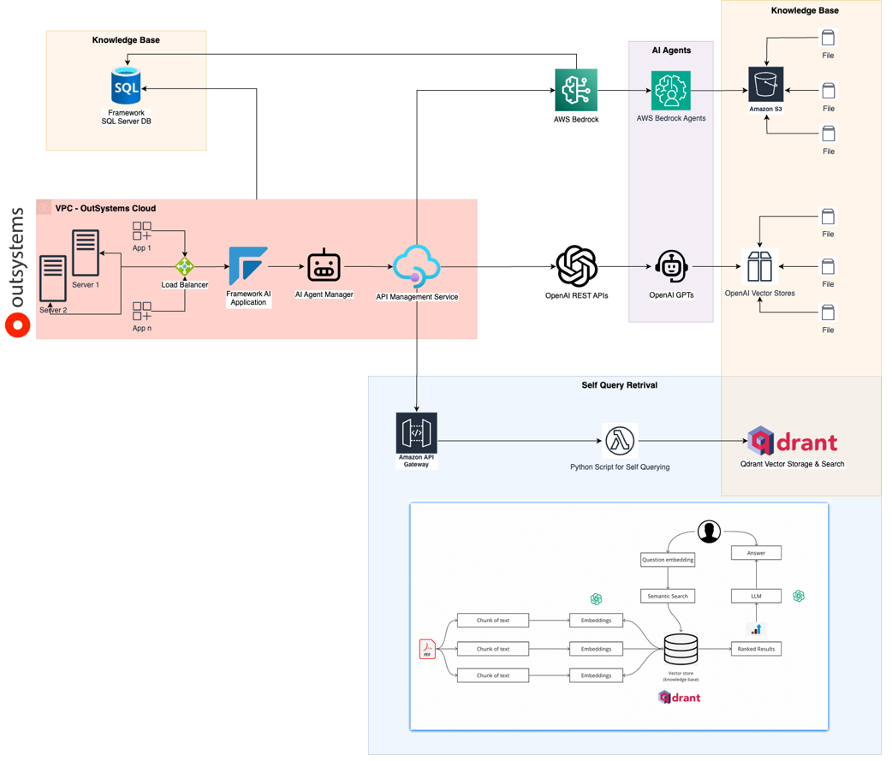
Jobs to Services Architecture
Job Data Input
LLM Process
Normalize Output
Human Feedback
Services
Customers
% FTE, etc.
Aligns to Any LLM
AI agents manage service changes, service value, talent pool, resource supply-demand

Slide 4
SMMS AI Agent Strategy
Service Management Model System — Talent+AI Agent Design,
Value Exchange Application & Prototype
HumanCentric Labs | April 16, 2026 | CONFIDENTIAL

Slide 5
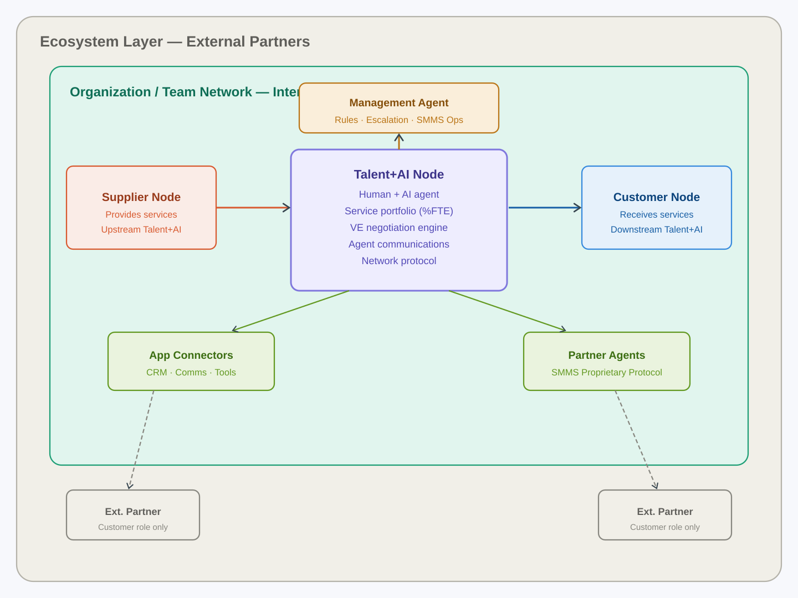
SMMS Agent Architecture
Three-layer network: individual Talent+AI node · organizational network · ecosystem

Slide 6
Agenda
01
Agent Strategic Approaches
04
Value Exchange (VE) Application
Three options — lightweight, federated, fine-tuned — with pros, cons & recommendation
Supplier-customer agent negotiation — full lifecycle design
02
SMMS Agent Architecture
05
VE Lifecycle Flow
Network topology: nodes, layers, protocol, app connectors, ecosystem
Six-phase process — connect, detect, negotiate, define, deliver, accept
03
Prototype Agent at Login
06
Requirements & Next Steps
Working Claude API prototype — service portfolio, VE status, communication drafting
Data model, technical decisions, clarifying questions, Cowork path

Slide 7
Three Agent Strategic Approaches
A
Embedded Lightweight
B
Federated Multi-LLM
C
HCL Fine-Tuned Agent
Open-source LLM bundled into SMMS login
Router: local for simple, licensed for complex
Proprietary model trained on SMMS domain
Pros
Pros
Pros
+ Near-zero per-user cost
+ Best-in-class capability
+ Deepest competitive moat
+ Full HCL IP control
+ Cost-controlled routing
+ Strongest IP position
+ Fast deployment
+ Upgradable components
+ Native SMMS fluency
Cons
Cons
Cons
− Limited capability ceiling
− Vendor LLM dependency
− 6–18 month runway
− Model maintenance burden
− API costs scale
− Highest upfront cost
Recommendation: Start with A. Build SMMS protocol for B/C compatibility. Design agent interface as model-agnostic from day one.

Slide 8
Prototype Agent — SMMS Login
Live Working Prototype
Your Talent+AI Agent ●
• Claude API (claude-sonnet-4-20250514)
Welcome back. I'm your Talent+AI agent. I can help you manage your service portfolio, communicate with your team and customers, and track value exchange negotiations.
• Service portfolio awareness at login
• Active VE negotiation pre-loaded in context
• Communication drafting capability
• Quick-action interface: My Services, VE Status, Draft Comms, Top Customers
My services
VE status
• Multi-turn conversation with history
Draft comms
Top customers
• Model-agnostic — LLM swap without UX change
Ask your agent...
Send ↗
Built on Claude API · System prompt encodes full SMMS context at login · Model-agnostic interface

Slide 9
Value Exchange (VE) Application
Agent-to-agent negotiation of supplier-customer service agreements at scale
S
Service
Value exchange between Talent+AI supplier and customer(s), expressed as %FTE
VE
Value Exchange
Live agreement between supplier & customer agents with full service attribute set
VC
Value Chain
Recursive graph: Customer 1 is simultaneously Supplier 1 to their own downstream customers
N
Negotiation
Automated agent process to resolve gaps, propose solutions, agree to changes
M
Mgmt Agent
Supervisory agent: applies SMMS rules, monitors VE frequency, escalates to human Talent

Slide 10
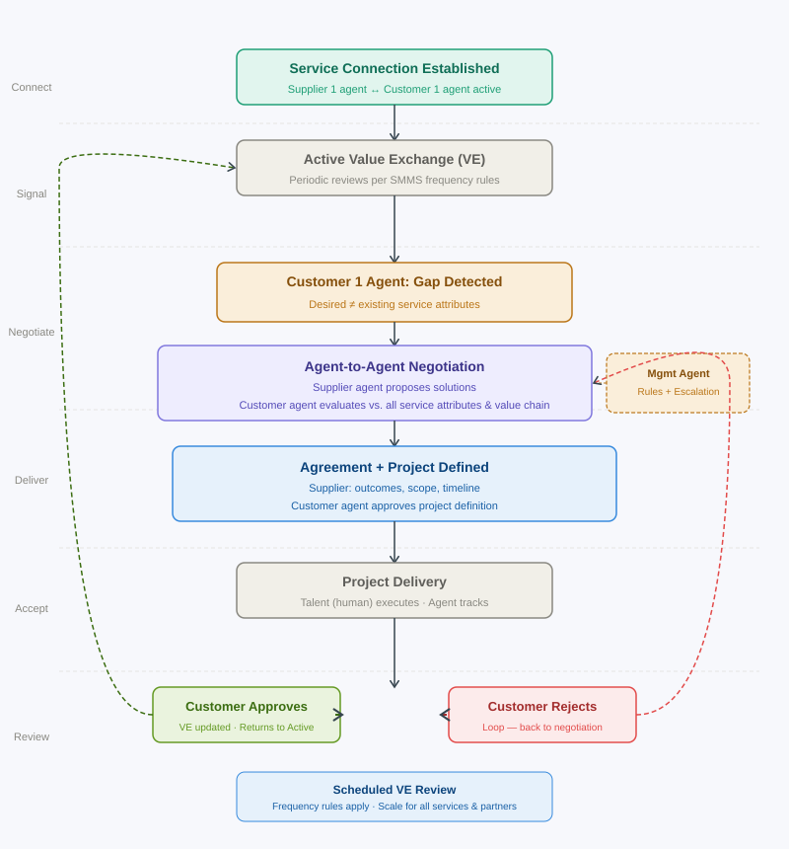
VE Lifecycle — Six-Phase Process
From service connection through change request · negotiation · delivery · acceptance · scheduled review

Slide 11
Three VE Design Options
Option 1
Option 2
Option 3
Sequential State Machine
Event-Driven Multi-Agent
Value Chain Blockchain
Simplest to build
Recommended for production
Long-term strategic
• Finite state machine per service-customer pair
• Independent VE process per supplier-customer pair
• Each VE agreement tokenized on internal ledger
• Active → Change Req → Negotiating → Defining → Delivering → Acceptance
• Shared message bus for agent communication
• Changes & acceptances are auditable transactions
• Rules determine auto-resolve vs. escalate
• Management agent monitors all VEs with rule engine
• Enables tokenized SVM (IP Priority 7)
• Maps to IP Priority 4 claim
• Maps to IP Priority 2 + 4 simultaneously
• Build Option 2 first, add ledger as Phase 2
• Best for: initial implementation & testing
• Best for: full value chain awareness at scale
• Best for: highest IP value & ecosystem scale

Slide 12
Requirements & Next Steps
Data model needed
Clarifying questions
• Complete service attribute list (name, customer, %FTE, importance, quality, SVM)
? Service frequency: calendar cadence, trigger-based, or both?
• VE frequency rules — cadence and exception conditions
? Agent autonomy: what can supplier agent agree to independently?
• Escalation rules — what triggers human Talent involvement
? External partner protocol: same as internal or restricted?
• Negotiation rule set — permissible solution types per agent
? Multi-service awareness in negotiation — include or scope later?
• Customer downstream awareness scope
? SVM currency: show numerically now or future layer?
Recommended Next Step: Initiate as a Cowork / Claude Code project after clarifying questions answered. Use Login Prototype as design reference.

Slide 13
Building the AI Agent Layer
of the New Hybrid Workforce
SMMS · Talent+AI · Value Exchange · HumanCentric Labs
CONFIDENTIAL & ATTORNEY-CLIENT PRIVILEGED | April 16, 2026

Slide 14
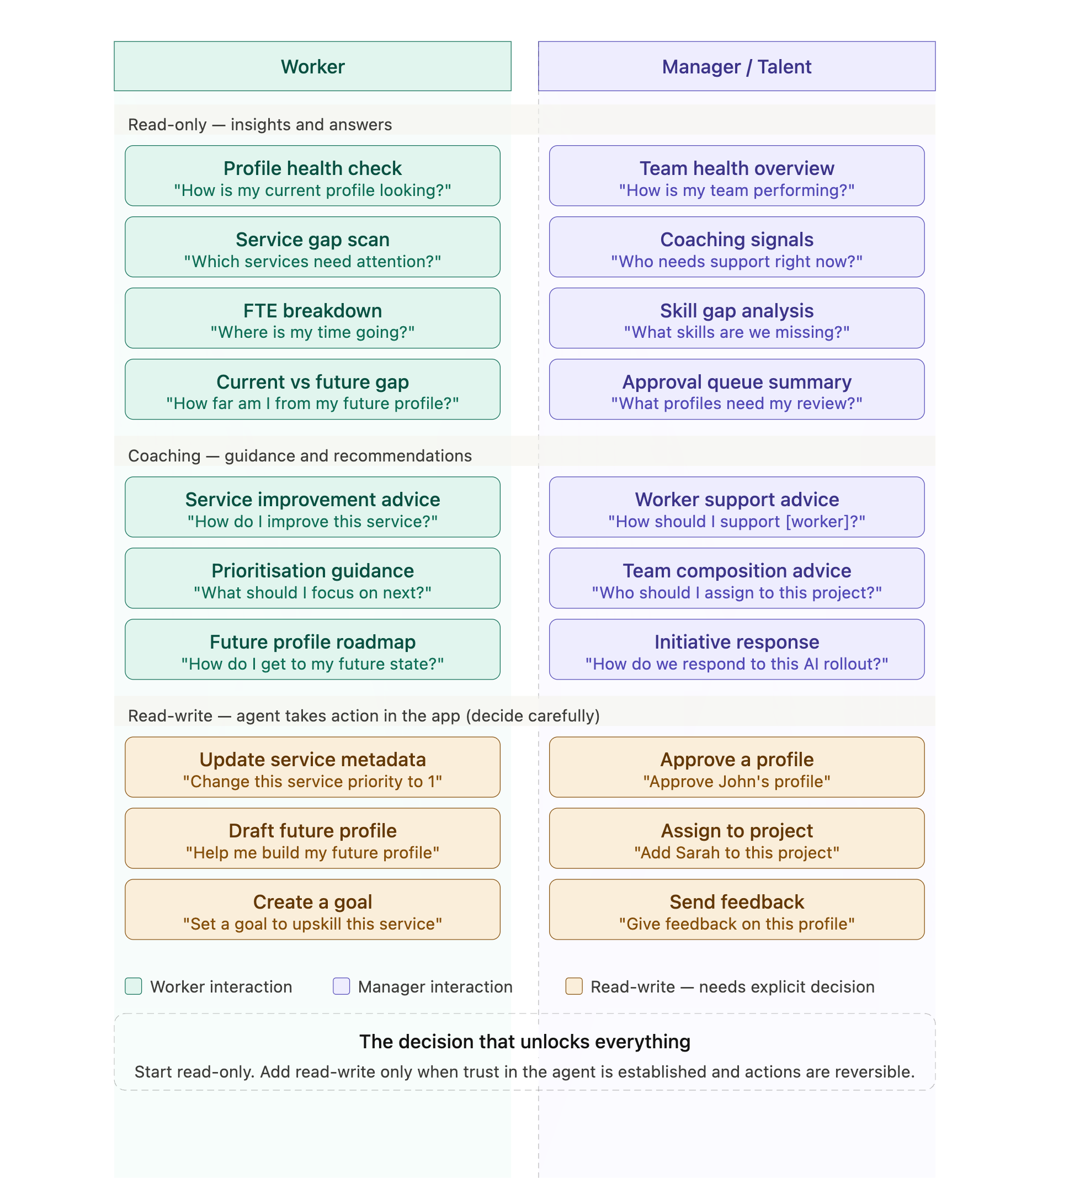
Talent Continuous Improvement
Coaching/Training
Talent and Agent Decision Making

